Slide 1


Understanding Droplet Bridging in Ionic Liquid-Based Pickering Emulsions
Elizabeth M. Walker, Denzil S. Frost, Jared J. Schoepf,
and Lenore L. Dai
School for Engineering of Matter, Transport, and Energy
Arizona State University, Tempe, AZ

Slide 2
Outline
Introduction
Motivation
Oil-in-Ionic Liquid Pickering Emulsions
Water-in-Ionic Liquid Pickering Emulsions
Summary
Acknowledgements

Slide 3
Self-Assembly at Liquid-Liquid Interfaces
Conventional Emulsions
(surfactant-stabilized)
Pickering Emulsions
(solid-stabilized)
B
B
B
A
A
γ
A
A
sA
Examples:
BSA
Milk (o-in-w)
Butter (w-in-o)
Examples:
Oil Recovery
Novel Synthesis of
Materials
Drug Delivery

Slide 4
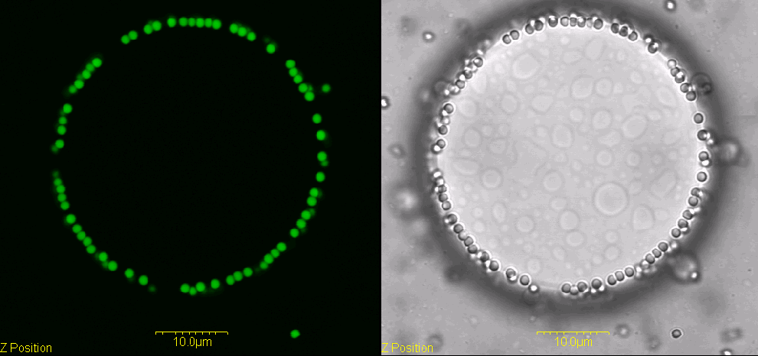
Relative Desorption Energies
Free energy to remove a microparticle from interface
  ∆𝐺=𝜋𝑟²𝛾(1±cos𝜃)
  On the order of 10⁷ kT
HUGE compared to
  Thermal Energy ~ kT
  Desorption of surfactants in conventional emulsion interfaces ~ 10 - 20 kT
Oil
Water
θ
Oil
Oil
Water
S-PS, 1 μm
Notes:
Scale: 10 micron
{{ 230 Koretsky, A. F. 1971;231 Tadros, T. F. 1983;232 Levine, S. 1989;}}

Slide 5
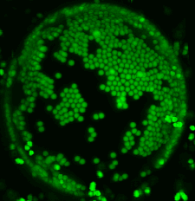
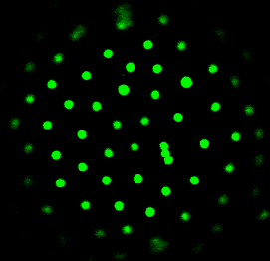
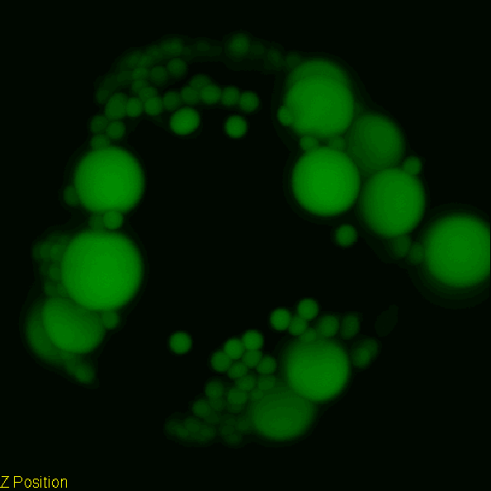
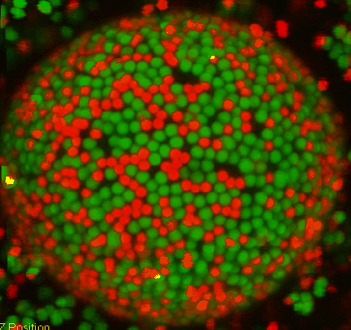
Oil-in-Water Pickering Emulsions
Aggregated Domains or Ordered Lattices
  Monolayers
No transport into droplets
Self-assembly of Heterogeneous particles
  Differing particle size
  Hydrophobic and Hydrophilic
S-PS / C-PS
S. Tarimala and L. Dai, Langmuir, 2004, 20, 3492.
L. Dai, et al., Scanning, 2008, 30, 87.

Slide 6
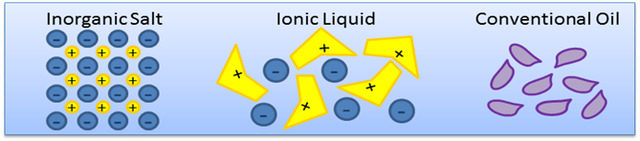
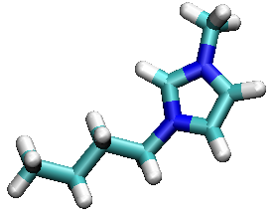
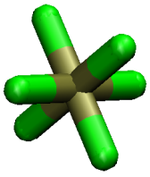
Motivation for Ionic Liquids
Liquids composed solely of ions
  Irregular shape resists packing
Negligible Vapor Pressure
High Chemical Stability
Applications
  Reaction Media
  Extraction
  Lubricants
  CO₂ Absorption
+
-
1-butyl-3-methylimidazolium hexafluorophosphate [BMIM][PF₆]

Slide 7
Oil-in-Ionic Liquid Pickering Emulsions
S-PS
AS-PS
S-PS, C-PS, and AS-PS result in highly bridged systems
  Particles bridge oil droplets across ultrathin layer of IL
  Particles not found at the IL-oil interfaces
A-PS results in low bridging
  Only 2 or 3 droplets
  More droplet coverage overall
C-PS
A-PS
E. Walker, D. Frost, and L. Dai., JCIS, 2011, 363, 307.
Notes:
Scale bars: 25 micron
SPS, etc: high deformations
APS: low deformation, saw droplets coalesce as you watched, suggests bridging prevents coalescence

Slide 8
Droplet and Emulsion Stability
Bridging Distresses Overall Stability
  With particles: stable for 2.5 hr
  Without particles: stable for 23.5 hr
Buoyancy Effects
  Particles act as creaming agents
Cream layer stable for > 60 days
S-PS AS-PS C-PS A-PS None
(a) t = 0, (b) t = 2.5 hr, (c) t = 6.5 hr, (d) t = 23.5 hr
S-PS cream layer after 60 days

Slide 9
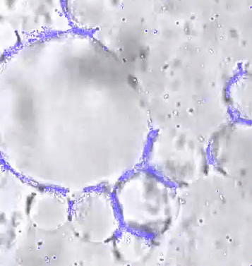
Particle Dynamics
t = 0 min
t = 5 min
t = 10 min
t = 13 min
Notes:
Initially Brownian motion, then irreversibly sticks due to particle-particle interactions

Slide 10
Water-in-Ionic Liquid Pickering Emulsions
S-PS
AS-PS
S-PS, C-PS, and AS-PS result in bridged systems
  Particles not found at the IL-oil interfaces
A-PS results in low bridging
Very similar to oil-IL
C-PS
A-PS

Slide 11
Bridge Formation
Limited role of contact angle
  Both water-IL and oil-IL form with various particle chemistries
High viscosity system
  Water-Oil system with oil of similar viscosity didn’t bridge
Low interfacial tension
  Decanol experiment disproves
IL “layering”
  MD Simulation: D. Frost and L. Dai, Langmuir, 2011, 27, 11339.
Some other driving force?
1
2
3
Notes:
Water-IL: ~10 mN/m
Oil-IL: 13.5 ± 0.1 mN/m
Oil-Water: ~40 mN/m
Water-Decanol: ~8 mN/m
No Bridging!

Slide 12
Summary
We studied Ionic Liquid-based Pickering emulsions stabilized by PS particles with different surface chemistries.
Oil-in-Ionic Liquid
  Morphology: bridged droplets, few particles at oil-IL interface
  Bridging distressed the overall emulsion stability
Water-in-Ionic Liquid
  Morphology: bridged droplets, few particles at water-IL interface, “stacking” of droplets
  Bridging distressed the overall emulsion stability

Slide 13
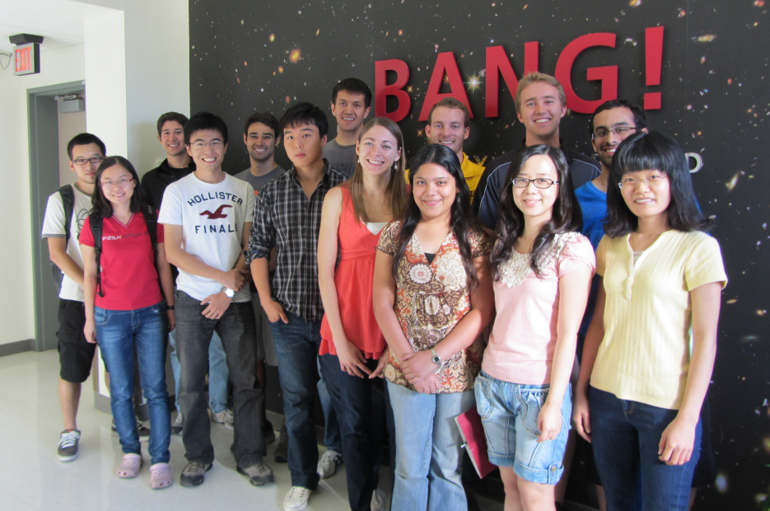
Acknowledgements
Arizona State University/NASA Space Grant
Arizona State University Fulton Undergraduate Research Initiative
National Science Foundation CBET-0922277
Science Foundation of Arizona Fellowship 0447-10
Notes:
NASA – both me and Denny

Slide 14
Thank You
elizabeth.walker@asu.edu

Slide 15
Monolayer Bridges
C-PS monolayer bridge
Notes:
Water-IL: ~10 mN/m
Oil-Water: ~40 mN/m
Oil-IL: 13.5 ± 0.1 mN/m
Water-Decanol: ~8 mN/m
No Bridging!

Slide 16
Materials and Methods
Materials
  IL: [BMIM][PF₆]
  Oil: PDMS (Rhodorsil Fluid V20)
  Water: HPLC Grade
  Particles: FluoSpheres polystyrene microparticles
Type | Surface Dissociable Group | Diameter (μm) | Surface Charge Density (C/m²) | Excitation/emission Wavelengths (nm)
S-PS | Sulfate | 1.0 ± 0.031 | -0.029 | 580/605
AS-PS | Aldehyde Sulfate | 1.0 ± 0.028 | -0.088 | 505/515
C-PS | Carboxylate | 1.1 ± 0.035 | -0.325 | 540/560
A-PS | Amine | 1.0 ± 0.023 | 0.152 | 505/515
Methods
  Prepare Pickering emulsions (0.002 g dry weight particles : 0.1 g droplet : 1.1 g bulk) using an ultrasonic process
  Characterize with confocal laser scanning microscope

Slide 17
Effect of Particle Heterogeneity
A-PS / S-PS
C-PS / S-PS
Self-assemble heterogeneous particles
  Equally dispersed
  Positively and negatively charged (when dissociated)
  Hydrophilic and hydrophobic
Notes:
A-PS wouldn’t bridge on its own

